Slide 1
Nexus
A BIS Innovation Hub project to improve cross-border payments

Slide 2
Nexus – Cross-border payments
Topic: Linking instant payment systems across borders
History: BIS Innovation Hub project, started late 2020
Why this is important to Mojaloop: opens possibility of providing cross-border payments to many more countries, without relying on traditional correspondent banking
What is the Business Impact: a new and faster way to send or receive remittances
Presenter Notes:
Please remember we have NEW folks attending the event for the first time and we need to bring them along.
Please spend 1-3 minutes addressing these areas

Slide 3
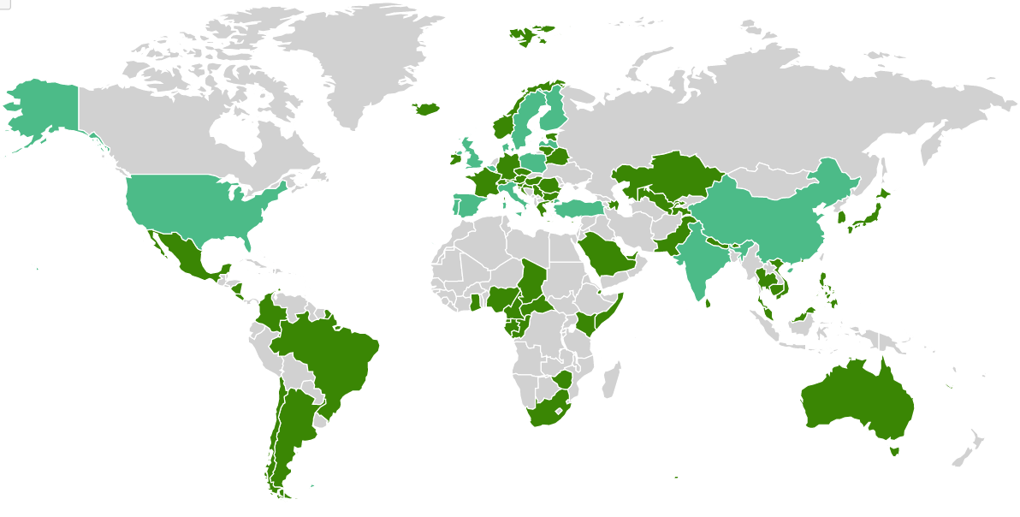



Vision: Connecting up to 60 existing Instant Payment Systems
+ Indonesia (Dec ‘21)
= only 1 IPS
= more than 1 IPS
= no IPS
Source: https://fastpayments.worldbank.org/

Slide 4















Bilateral linkages are starting to happen…
Multiple bilateral (country-to-country) initiatives underway
Non-standard approaches
S. Korea
Malaysia
Thailand
India
USA TCH-RTP
EBA RT1
Philippines
Live / Pilot
WIP
Singapore
Statement of intent
Sweden
QR
Indonesia
4
Notes:
This is a non-exhaustive list of regional and global bilateral linkage projects. It is worth noting that both public and private sector led are taking place.
From our perspective, we celebrate these bilateral initiatives which serve to (a) prove that interlinking is possible and (b) produce a wealth of experience and insight.
However, any successfully payment system ultimately relies on network effects and it is our view that long term, a multilateral approach will be required.

Slide 5
Obstacles to linking IPS
Need to overcome differences between IPS designs:
data formats, standards and mandatory fields
processes and the sequence of steps in a payment process;
scheme rules around liability, disputes, data protection and privacy
functionality, including whether aliases are used and whether there is a confirmation of payee service.

Slide 6
So bilateral linking is not scalable
Gets harder and more complex as the network scales:
Too costly for an IPS operator to build and maintain 19 custom links to other countries.
Complexity could harm resilience of the domestic IPS.
2 countries
1 link
3 countries
3 links
20
190
countries
60
1,770
countries
links
links
Leads to patchy networks between close trading partners, with majority of countries having no direct connection.
Number of links = n(n-1) ÷ 2 where n = number of countries

Slide 7





Nexus would connect multiple IPSs multilaterally
Nexus standardizes the way IPSs connect, reducing complexity
Each IPS integrates once, to Nexus, and can then route payments to any other country in the network.
Each IPS runs a Nexus Gateway
Domestic payments infrastructure is linked to the local Nexus Gateway
Nexus Gateways speak to each other across borders

Slide 8





Key functions of Nexus
FX Conversion
Competitive market of FX Providers
Nexus compiles current rates and provides them to banks/PSPs
Supports sanction screening
Screening is still responsibility of PSPs.
Nexus tries to get verified information from PSPs (rather than from the Sender), reducing false positives and manual intervention
Addressing & Proxy Lookup
Any domestic details are also valid through Nexus
Settlement not required
Relies on existing IPS settlement processes and risk management
No reliance on central bank’s RTGS
Messaging
Coordinates process across 2 IPSs and handle failures

Slide 9




Technical Proof-of-Concept (Jan-Dec 2022)
Outputs
Technical standard (open API specs, message specs, best practices)
Draft scheme (rules and processes, filling gaps in domestic schemes)
Working software, managing cross-border communication between IPSs
Eurozone
Singapore
Malaysia

